Slide 1

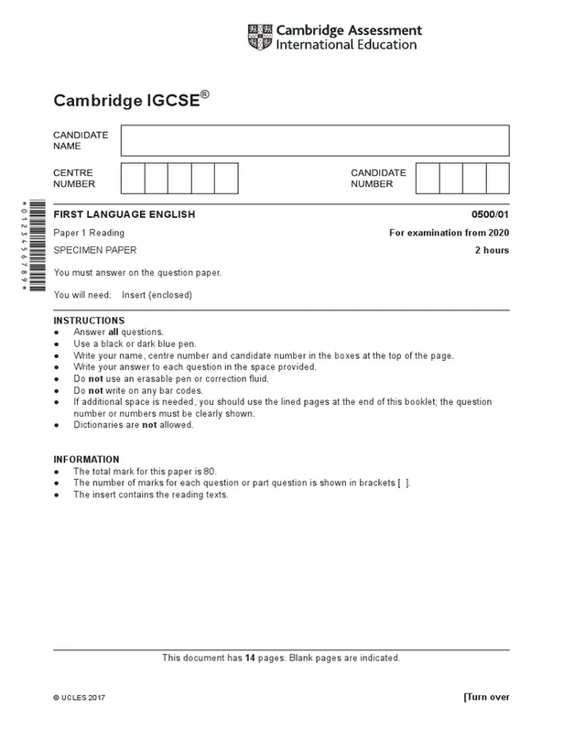





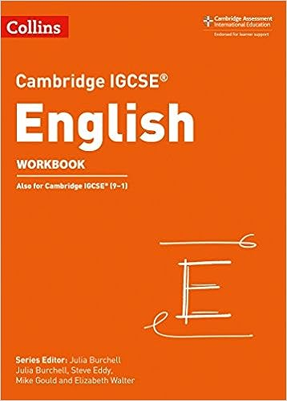




LO: To Understand FLE Writing Paper 2 - Q2 Narrative Writing

Slide 2
Why do we need to know?
In your exam, you will be asked to make a decision. There will be 4 tasks: 2 descriptive writing and 2 narrative writing tasks.
You must choose only 1 question.
Look at these example prompts. Can you work out which is narrative and which is descriptive?
Imagine you found a hidden garden. Describe your emotions and feeling as you discover it, and what is remarkable about it.
Write a story which begins with you overhearing a phone call which is meant to be a secret.

Slide 3
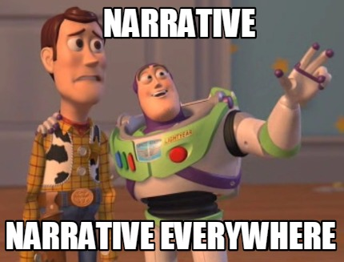
Narrative Writing
Narrative writing is used to relate a series of imagined or real events in an organized sequence.
Most narratives are stories that make a point or lead us to reflect on some aspect of life.
Narratives also provide entertainment by conveying action and conflict within the writing.
Usually a narrative will talk about a conflict, have a climax that creates tension, and ultimately resolve the issue.

Slide 4

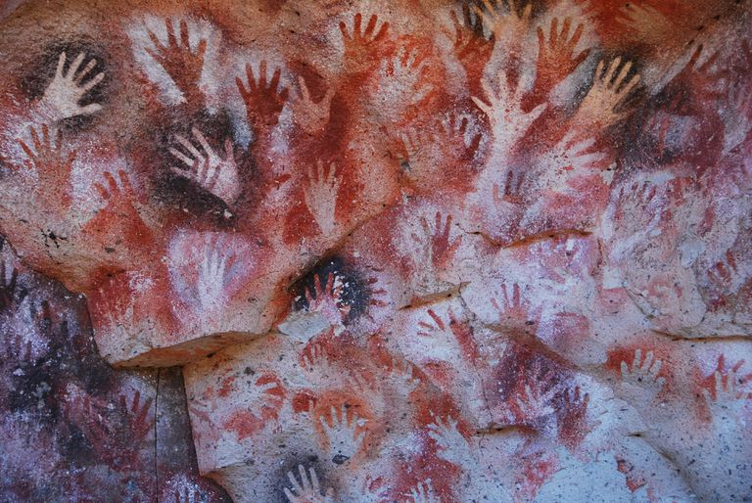
What is a story?
Why do they exist?

Slide 5
What should a good story have?
Interesting characters who you are able to react to: with care, envy, loathing, repulsion...anything!
A gripping hook at the start to make your reader interested and unable to stop reading.
A believable problem for your protagonist to overcome.
A message or theme you want your readers to take away.
A sense of tension and suspense: what is going to happen? Things must get worse for your characters before they can get better.
A satisfying ending: did all characters’ arcs come to a conclusion? Were the mysteries answered consistently? Do you leave your reader wanting more?
A clear and consistent setting: can the reader tell what time and place this is set in without you having to tell them?
A sense of mystery or intrigue: why are the characters doing this? Who are they? What has happened to them? What is the object in her pocket? Who is the person he keeps referring to?
Notes:
Post it notes

Slide 6
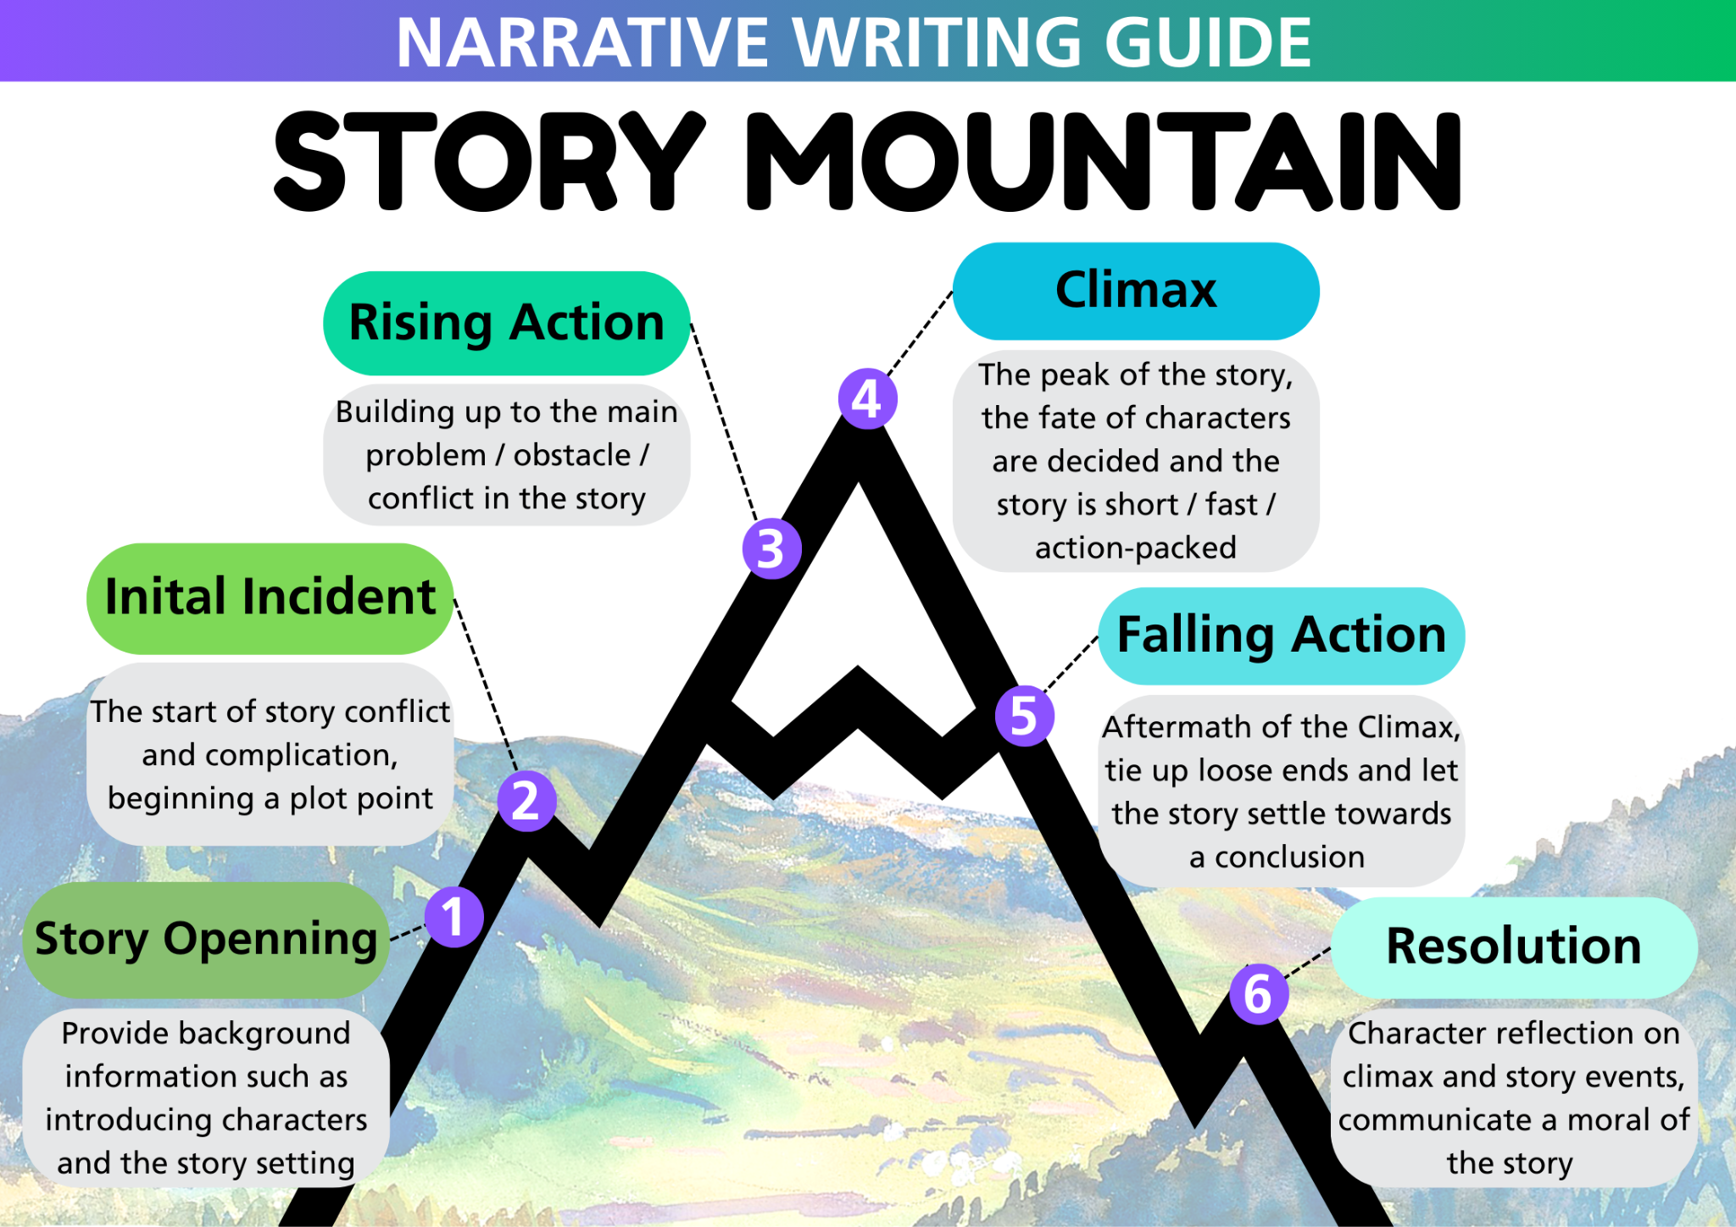

Slide 7
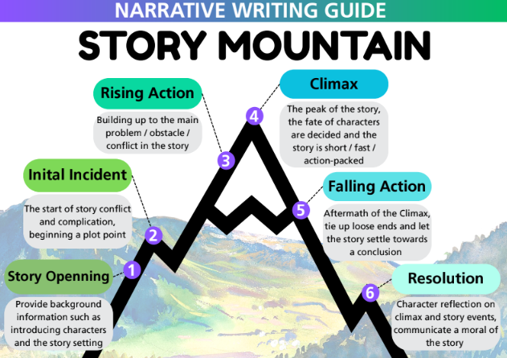
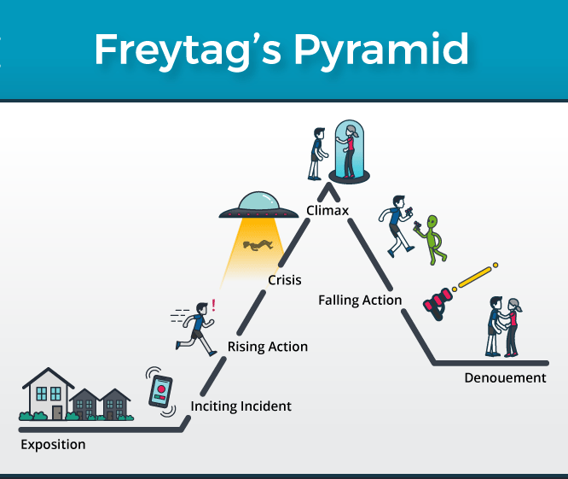
Think of some stories you know and explain how they fit this structure?
Get into groups of 3 - Create a presentation for a story that follows this narrative
Notes:
https://blog.reedsy.com/guide/story-structure/

Slide 8
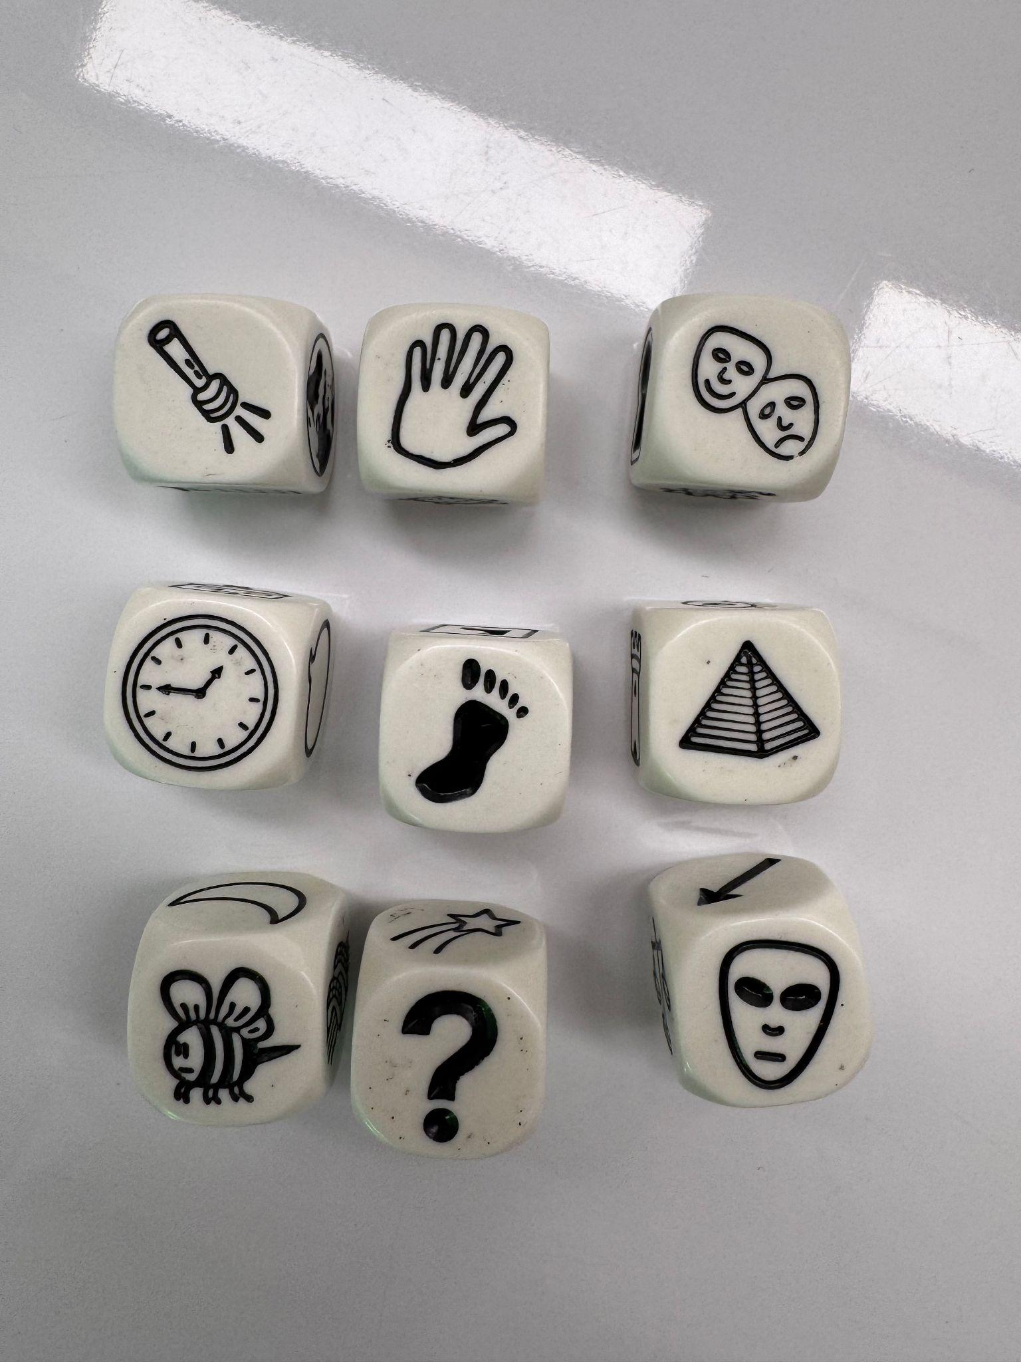
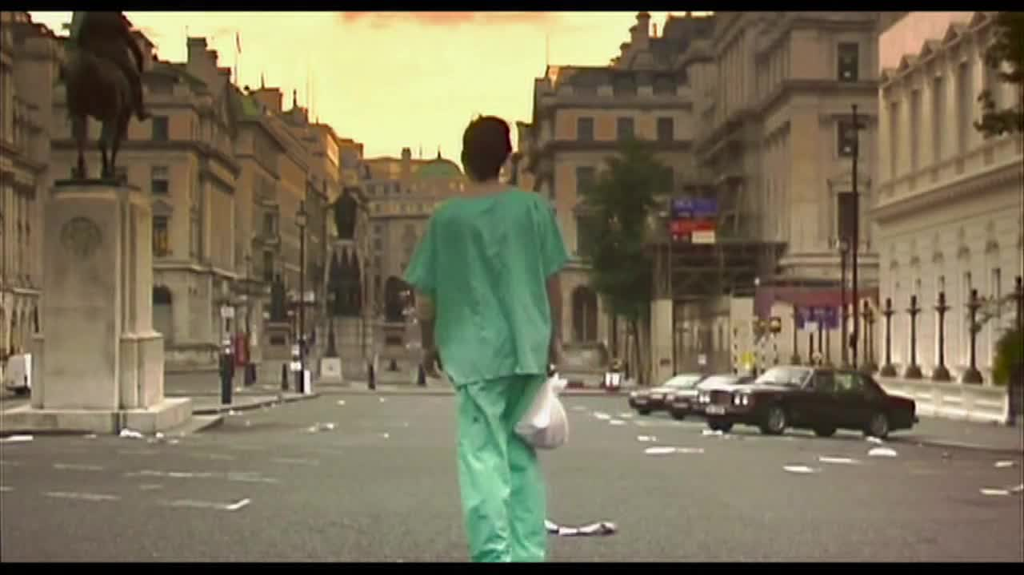
Flash Fiction You have 10 mins to write the opening to a narrative.
You don’t have time to plan – just put your brain into gear and write!
@<<12:00-@>>
Prompt: You wake up in a hospital bed and there is no one else around. You don’t know what happened or how you got here (yes, I know this is a cliché zombie opener!).

Slide 9
Collaborative Flash Fiction Move the paper along your table table. You have 3mins to add at least 50 words to your peer’s story.
Let’s read your flash stories!
What does/doesn’t work about them and why?
Collaborative Flash Fiction Round 2 Move one place along the table again. You have 3mins to add at least one sentence containing the word ‘marshmallow’.
Collaborative Flash Fiction Round 3 Move one place along the table again. You have 3mins to add more to the story. You must include a simile.
Collaborative Flash Fiction Final Round Return to your own story and end it in the next 3 minutes using one of these words - sponge, Bob, square, pants - somewhere in your writing.

Slide 10
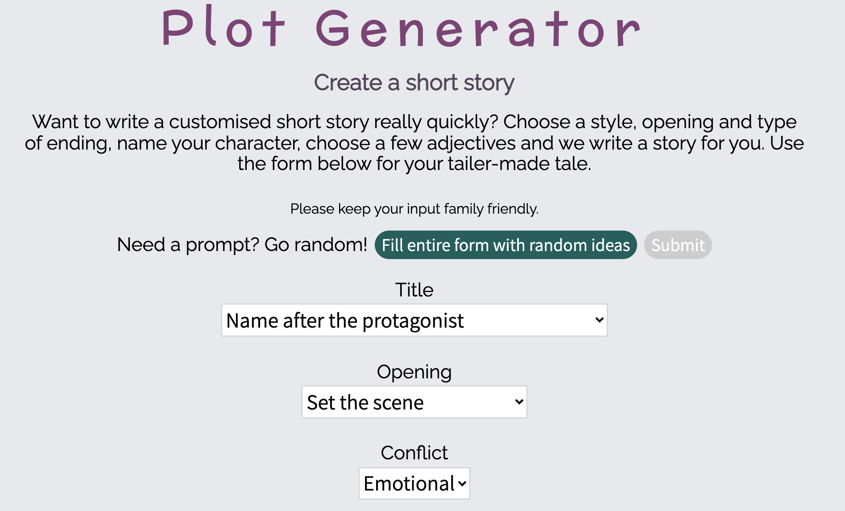
Use https://www.plot-generator.org.uk/story/ to create a short story (read your outcome and compare it to the person next to you.
Was it a good story?
Do you think author’s use tools like this?
Why or why not?

Slide 11
Why do we need to know?
In your exam, you will be asked to make a decision. There will be 4 tasks: 2 descriptive writing and 2 narrative writing tasks.
You must choose only 1 question.
Look at these example prompts. Can you work out which is narrative and which is descriptive?
Imagine you found a hidden garden. Describe your emotions and feeling as you discover it, and what is remarkable about it.
Write a story which begins with you overhearing a phone call which is meant to be a secret.

